Slide 1
AML/CFT¹ Regime for Regulated Dealers Onboarding conference
AML/CFT Division
Ministry of Law
Jun 2019
¹AML/CFT: Anti-money laundering/countering the financing of terrorism

Slide 2
opening address
By the Registrar of Regulated Dealers
Notes:
Presentation duration: 10 minutes
9.35am to 9.45am

Slide 3



Opening Address by the Registrar of Regulated Dealers
Why the new laws, requirements and regime for regulated dealers?
On-going preventive action
Safeguard the precious stones and precious metals (“PSPM”) sector from money laundering and terrorism financing (“ML/TF”)
Protect Singapore’s reputation and preserve trust in the sector
How will the regime
be implemented?
Phased approach
Shared ownership and responsibility
Risk-based principles
Firm and fair regulatory actions
How will the regulator
interact with regulated dealers?
Values that underpin our actions/interaction
Integrity – accountable and mission-focused
Service – facilitative and collaborative
Excellence – proactive and innovative

Slide 4
regulatory requirements
What am I required to do as a regulated dealer?
By Joanne Koh, Senior Assistant Director/ACD
Notes:
Presentation duration: 45 minutes
9.45am to 10.30am

Slide 5
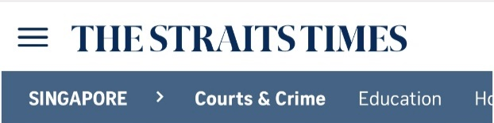
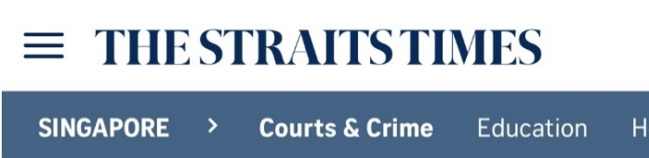
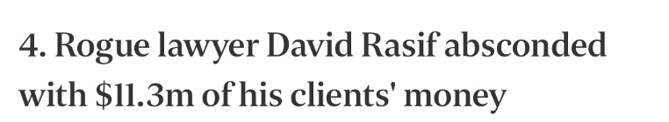
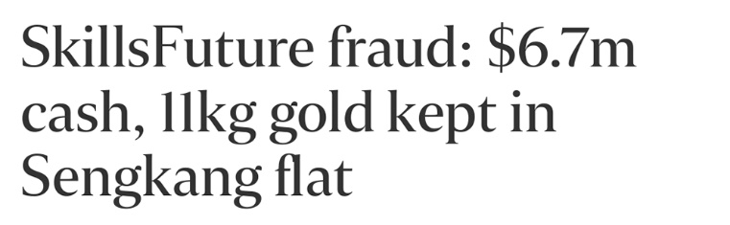
Money Laundering Cases Relating to PSMDs in Singapore
Took place in 2006:
“In 2010, the Commercial Affairs Department (CAD) here was able to recover $6.4 million in cash and gold both here and abroad.
CAD had also been able to seize 40 of the 47 gold bars that Rasif had bought for $1.65 million in June 2006.”
Took place in 2018:
“…was sentenced to five years and eight months in jail for money laundering.
On Oct 30 and 31 last year, she bought 6kg of gold bars worth $344,000 from two jewellery shops…
…collect another five 1kg gold bars worth $282,500. By Nov 1, there were $6.7 million in cash and 11kg of gold in the safe.”
[Credit: The Straits Times, Jan 15, 2015 and Nov 28, 2018]
Notes:
Singapore is vulnerable to ML and TF. In our 2013 National Risk Assessment, it was noted that “Singapore has one of the lowest crime rates in the world…… the bulk of Singapore’s exposure to ML/TF risks arises from offences committed overseas. As an international transport hub and financial center, Singapore is a potential transit point for illicit funds.
From the typologies, both domestic and international, intelligence reports we have received, we have observed that there are real risks in the PSMD sector and additional proportionate measures needs to be taken. Aside from ML/TF, we have noted PSMs, particularly gold, being used to affiliate PF.
Singapore has been featured in international news related to money laundering. Most famously, 1MDB.
We have taken stern action. For 1MDB, MAS closed 2 banks, fined a number of banks for a total of $30m.
Here are two examples.
The David Rasif case, where a lawyer absconded with millions of dollars in his clients’ money, and stashed part of the proceeds in gold bars.
The SkillsFuture fraud case in 2018. Likewise, proceeds were stashed in gold bars.

Slide 6
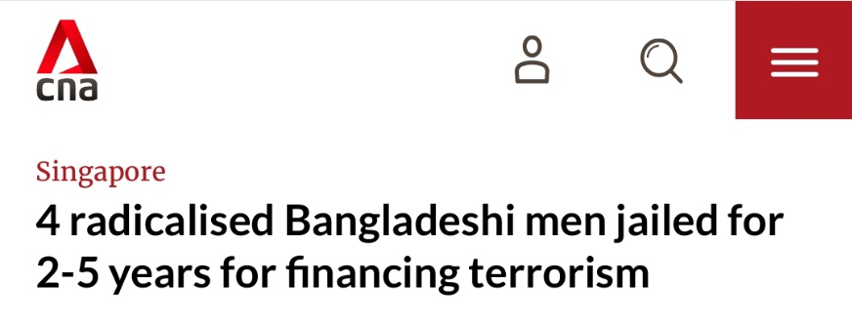
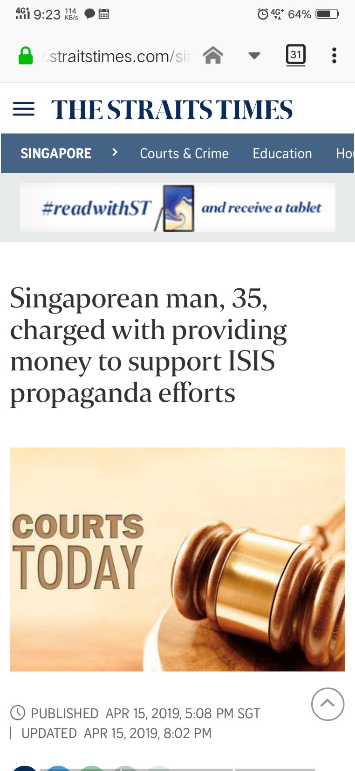
Terrorism Financing Cases in Singapore
Took place in 2016:
“Four Bangladeshi nationals… conviction under the Terrorism (Suppression of Financing) Act.
They formed ‘lone-wolf pro-ISIS terrorist group’.
He had donated $300 to the cause. Documents on weapons and bomb making…
Four men detained under Internal Security Act.”
Took place in 2019:
“…provided $450 to an individual in Turkey on Oct 31, 2014, for the publication of ISIS propaganda.
“This act of providing money in support of terrorist purposes is a serious offence, regardless of the amount, under the Terrorism (Suppression of Financing) Act”, said MHA.”
[Credit: CNA, Jul 12, 2016 and The Straits Times, Apr 15, 2019 ]
Notes:
Similarly, we have seen cases of terrorism financing.
Take the recent case involving four Bangladeshi nationals, who formed a lone-wolf pro-ISIS terrorist group.
Or a case where a single Singaporean man was found to have provided money for ISIS propaganda efforts.
There are more examples. Point here is this.
As an international hub for business, trade, tourism, we are clearly exposed to money laundering and terrorism financing risks.
It threatens our safety.
It affects our international reputation.
If more such cases, global community will have less reason to trust us.
In this industry, you know how important trust and reputation is. It is priceless.
We need to demonstrate real action, meaningful efforts to close gaps and protect ourselves from such risks.
This is why we have introduced a new AML/CFT regime for the precious stones and precious metals dealers sector.

Slide 7






What is Money Laundering?
Money laundering is the process of concealing the proceeds of a crime so that they appear to have originated from legitimate sources.
Money Laundering Cycle
1. Placement
Criminal activities
Illegal proceeds are physically disposed
E.g. Purchase or sale of precious stones and precious metals using illegal proceeds
Collection of criminal proceeds
E.g. Proceeds obtained from illegal activities, e.g. drug trafficking, theft
3. Integration
Laundered proceeds placed back into the financial system
E.g. Cash obtained from the sale of precious stones and precious metals banked into an account without detection
2. Layering
Layers of financial transactions created to disguise source
E.g. Repeated transactions involving precious stones and precious metals
Notes:
Our regulations are focused on money laundering and terrorism financing (ML/TF). What is ML/TF?
For ML, it is technically broken up into 3 stages.
Placement. Converting criminal proceeds into other assets. In our case, it could be gold bars, diamonds, watches.
Layering. This is about hiding the source of funds. After buying the gold or jewellery, the criminal could hide the purchase in multiple, complex transactions.
Integration. The criminal needs to convert the gold or jewellery back into cash. With precious stones and precious metals, many of which have a high resale value, this is not difficult. Once done, hard to trace its origin in crime.
In short, money laundering is the process of making proceeds of crime appear to be from legitimate sources.
Customer due diligence (CDD) arrests this process at the start. It prevents layering, because the system ensures that high-value purchases be made in cash without identification. If effective, this system is a big help to the overall AML/CFT framework for Singapore.

Slide 8





What is Terrorism Financing?
Terrorism financing is the funding of terrorism or terrorist groups. Sources of terrorism financing may be legitimate or illegitimate.
Terrorist activities
Purchase precious stones and precious metals
Resale of precious stones and precious metals
Raise funds
Purchase precious stones and precious metals in Singapore
Resale of precious stones and precious metals abroad at higher price
Profits derived from sale of precious stones and precious metals
Notes:
Terrorism financing is the provision of property and services for terrorist acts.
This financing could include both criminal sources and clean sources.
Criminal sources e.g. Abu Sayyaf group in Phillipines is infamous for kidnapping and extortion.
Legitimate sources e.g. 6 Bangadeshi migrant workers charged in Singapore used their own salary, the Jelamiah Islamiyah in 2001 were funded from salary. Recent typologies cited the mining and sale of precious stones and precious metals in areas controlled by ISIL.
From the wide definition of ML and TF, it could be easy for you to unwittingly help a criminal or terrorists. Many of you will realise that having legislation, regulations and guidance specific to your sector, could help you put up defences to reduce the risks.

Slide 9
PSPM Act
NEW LAW IMPLEMENTED
The Precious Stones and Precious Metals (Prevention of Money Laundering and Terrorism Financing) Act 2019 (“PSPM Act”) came into force on 10 April 2019.
Part |  | Key areas to note
1 | Preliminary | Definitions of terms used Appointment of Registrar and officers
2 | Registration of regulated dealers | Registration Regulatory action
3 | Prevention of money laundering and terrorism financing | Customer due diligence Cash transaction reports Keeping of records Programmes and measures Disclosure of suspicious transactions
4 | Monitoring and enforcement | Powers of monitoring and investigation Power to seize
5 | General offences | Providing false information Obstruction of investigation
6 | General | Disclosure of information Composition of offences Power to publish information
An Act to regulate persons who carry on a business of regulated dealing
or as an intermediary for regulated dealing,
so as to prevent money laundering and terrorism financing.
* Detailed requirements in the Precious Stones and Precious Metals (Prevention of Money Laundering and Terrorism Financing) Regulations 2019 (“PMLTF Regulations”)
Notes:
This slide gives an overview of the main legislation – the Precious Stones and Precious Metals (Prevention of Money Laundering and Terrorism Financing) Act 2019 (PSPM Act).
Detailed requirements in the Precious Stones and Precious Metals (Prevention of Money Laundering and Terrorism Financing) Regulations 2019 (“PMLTF Regulations”)
To help dealers understand and comply with these legal requirements, we have prepared a set of Guidelines to help you comply with the requirements. They can be downloaded at the MinLaw website.
I will go through the main parts of the PSPM Act that you need to know about.

Slide 10







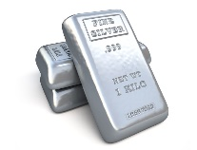
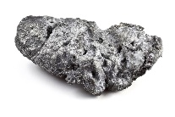
Scope / Registration
What is covered?
Precious stones, precious metals, precious products
and asset-backed tokens (“PSPM”).
Precious stones
Precious metals
Diamond
Sapphire
Gold
Silver
Ruby
Emerald
Platinum
Palladium
Rhodium
Iridium
Jade
Pearl
Osmium
Ruthenium
Alloy with at least 2% of PSPM in weight
Notes:
PSPM can mean any of the 6 precious stones, 8 precious metals or alloys, precious products and asset-backed tokens.
Precious stones: Diamond, Sapphire, Ruby, Emerald, Jade, Pearl. Semi-precious stones like topaz, amethyst, etc. – NOT included
Precious metals: Gold, Silver, Platinum, Palladium, Rhodium, Iridium, Osmium, Ruthenium. And any alloy with at least 2% of the PSPM in weight.

Slide 11

Scope / Registration
What is covered?
Precious stones, precious metals, precious products
and asset-backed tokens (“PSPM”).
Precious products
Asset-backed tokens
Any jewellery, watch, apparel, accessory, ornament or other finished product, which is made up of (containing or attached) any PSPM
AND
at least 50% of its value due to the PSPM
Any token, certificate or other instrument backed by one or more precious metals, precious stones or precious products
That entitles the holder to the precious metal, precious stone or precious product.
Notes:
Precious Products: To determine if an item is a precious product, you should consider its composition. If at least 50% of value comes from precious stones or precious metals, then it is a precious product.
It is the dealer’s responsibility to assess if it deals in any precious product, based on the selling price of the product and the market value of its components.
As part of our regular supervisory actions, ACD will conduct checks to ensure that there are no breaches of the PSPM Act by dealers transacting in Precious Products.
Enforcement actions will be taken against any breaches.
Asset-backed tokens: xx

Slide 12


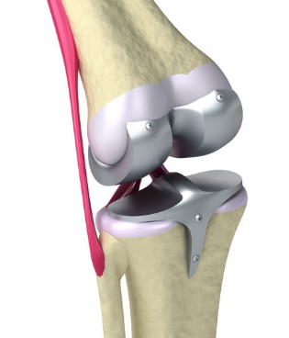

Scope / Registration
What is not covered?
Industrial tools and medical devices.
Any machinery, tool or equipment used for industrial purposes.
E.g. crucible, furnace coil.
Any medical device listed in the First Schedule of the Health Products Act (Cap. 122D).
E.g. Implants to body parts (knee/tooth implant).
Notes:
Industrial tools and medical devices are NOT covered under the PSPM Act. If you only deal in industrial tools or medical devices, even if they contain precious metal components, you do NOT have to register with us.
(For internal info:
Industrial: Platinum, rhodium and iridium are used in laboratory crucibles. Crucibles are commonly used for melting gold in your trade. Rhodium is also used in furnace coils.
Medical: Platinum is also used in medical devices such as knee implants. Another common medical device is tooth implant which uses gold alloy.)

Slide 13
Scope / Registration
Who is required to register?
Regulated dealers (Persons who carry on a business of regulated dealing, or business as an intermediary for regulated dealing.)
Manufacturing any PSPM
Importing or possessing for sale any PSPM
Selling or offering for sale any PSPM
Selling or redeeming asset-backed tokens
Purchasing any PSPM for the purposes of resale
Who is not required to register?
Pawnbrokers (regulated under Pawnbrokers Act)
Financial institutions (regulated by MAS)
Foreign dealers² (who carry on a business for not more than 90 days in a year, e.g. exhibition, fair.)
²Foreign dealers are subject to transaction-based requirements, except that they are not required to register and not subject to entity-based requirements.
Notes:
Now, let’s look at the scope of the PSPMA.
All regulated dealers are required to register, unless you are exempted. I’ll come to that later. Regulated dealer is defined as:
Manufacturing any PSPM
Importing or possessing for sale any PSPM
Selling or offering for sale any PSPM
Selling or redeeming asset-backed tokens (Internal: a token, certificate or other instrument backed by one or more precious stones, precious metals or precious products that entitles the holder to the precious stone, precious metal or precious product, or part of it, but excludes - (a) securities or derivatives contracts within the meaning of the Securities and Futures Act; and (b) commodity contracts within the meaning of the Commodity Trading Act.)
Purchasing any PSPM for the purposes of resale
Exceptions for registration:
Your business entity is a pawnbroker regulated under the Pawnbrokers Act
A financial institution regulated by the Monetary Authority of Singapore, or
A foreign dealer.
For the purposes of the PSPMA, a foreign dealer is defined as a dealer who carries on a business of regulated dealing for not more than 90 days in a calendar year.
In other words, if you as a foreign dealer do your business in Singapore for less than 90 days a year, you do not need to register, BUT you must still abide by a wide range of legal obligations, such as cash transaction reporting.

Slide 14
PSPM Act
NEW LAW IMPLEMENTED
The Precious Stones and Precious Metals (Prevention of Money Laundering and Terrorism Financing) Act 2019 (“PSPM Act”) came into force on 10 April 2019.
Part |  | Key areas to note
1 | Preliminary | Definitions of terms used Appointment of Registrar and officers
2 | Registration of regulated dealers | Registration Regulatory action
3 | Prevention of money laundering and terrorism financing | Customer due diligence Cash transaction reports Keeping of records Programmes and measures Disclosure of suspicious transactions
4 | Monitoring and enforcement | Powers of monitoring and investigation Power to seize
5 | General offences | Providing false information Obstruction of investigation
6 | General | Disclosure of information Composition of offences Power to publish information
An Act to regulate persons who carry on a business of regulated dealing
or as an intermediary for regulated dealing,
so as to prevent money laundering and terrorism financing.
* Detailed requirements in the Precious Stones and Precious Metals (Prevention of Money Laundering and Terrorism Financing) Regulations 2019 (“PMLTF Regulations”)
Notes:
Next I will talk about the main AML/CFT requirements of the Act.
There are two types of requirements.
Entity-based requirements, which apply to every single regulated dealer from the start.
And transaction-based requirements, which depend on the size and medium of your transaction, or the customer you are dealing with.

Slide 15



PMLTF Requirements
TF risk
ML risk
Entity-based requirements
Identify, assess and understand your ML/TF risks.
Develop your internal policies, procedures and controls (“IPPC”), a.k.a. SOP, to prevent ML/TF.
Train your staff in IPPC.
1
2
3
Remember, it is all about managing ML and TF risks!
Notes:
Three entity-based requirements. Every entity must… 1 2 3
Sample risk assessment form and sample IPPC document provided in Guidelines.

Slide 16



PMLTF Requirements
TF risk
ML risk
Transaction-based requirements
Conduct customer due diligence (“CDD”) under certain circumstances, file cash transaction reports (“CTR”) for cash transactions above S$20,000.
Conduct enhanced customer due diligence (“ECDD”) to assess if the customer is of higher-risk.
If found to be suspicious, terminate the transaction and file a suspicious transaction report (“STR”).
Keep records of designated transactions and related documents for 5 years.
1
2
3
Notes:
Transaction-based requirements.
Most important is to conduct CDD under certain specified circumstances. Guidelines say.
Transactions that exceed $20,000 in cash, or cash-equivalent
Cash equivalents refer to cash vouchers with cash value which may be exchanged for cash or for any precious stone, precious metal or precious product.
Suspicion of ML
Doubts about customer information previously obtained through CDD.
There is also an existing requirement to file CTRs for cash transactions above $20,000.
2. If suspicious, or high-risk: ECDD and STR
3. Keep records. Of your CDD, CTR, etc. for 5 years.
There are also sample CDD and ECDD form in the Guidelines. We encourage all of you to refer to the Guidelines to get you started.
Internal note: Did not indicate SCDD in step 2. Will not elaborate on SCDD in the conference. Fyi, SCDD is included in the Guidance Document.

Slide 17
Offences - Fines
Section 10(2) Regulatory action | Fine not exceeding $100,000.
Section 16(6) Customer due diligence | Fine not exceeding $100,000.
Section 18(5) Keeping of records | Fine not exceeding $100,000.
Section 19(3) Programmes and measures to prevent money laundering and terrorism financing | Fine not exceeding $100,000.
Section 20(2) Additional measures relating to targeted financial sanctions, etc. | Fine not exceeding $100,000.
Section 21(3) Disclosure of suspicious transactions, etc. | Fine not exceeding $20,000.
Section 22(5) Power to give directions | Fine not exceeding $20,000.

Slide 18
Offences - Fines and Imprisonment Terms
Section 6(2) No regulated dealing without registration | Fine not exceeding $75,000 or imprisonment for a term not exceeding 3 years or both. In the case of continuing offence, to a further fine not exceeding $7,500 for every day of part of a day during which the offence continues after conviction.
Section 17(4) Cash transaction reports | Fine not exceeding $20,000 or to imprisonment for a term not exceeding 2 years or to both.
Section 27 Providing false information to Registrar or authorised officer | Fine not exceeding $50,000 or to imprisonment for a term not exceeding 2 years or to both.
Section 28 Obstruction of investigation, etc. | Fine not exceeding $50,000 or to imprisonment for a term not exceeding 2 years or to both.
Section 39(3)(a) Regulations | Fine not exceeding $100,000 or with imprisonment for a term not exceeding 3 years or to both.

Slide 19
Outreach & Capability Development Plans - Tiered and Phased Approach
Phase 1
Awareness & Transition
Phase 2
Phased-In Compliance
Phase 3
Full Compliance
Mar 2019 to Sep 2019
(6 months)
Oct 2019 to Sep 2020
(12 months)
Oct 2020 onwards
Objectives
Create awareness of regime
Drive registration
Objectives
Raise AML/CFT awareness
Facilitate compliance
Objectives
Level up and sustain AML/CFT standards
Channels
Website, collaterals
Conference
Workshops
Channels
Workshops
Compliance Review Program
Channels
AML/CFT Training and Certification Program
Notes:
We know this regime is new to you and your colleagues. Some effort will be required to implement the new regime.
We want to help. We want to help you understand the importance of this regime, and to be very clear about what you need to do to protect yourself and your business from ML/TF risk.
So we have designed a comprehensive outreach and capability development plan. 3 phases.
Phase 1, focus on raising awareness and encouraging early registration
Phase 2, focus on developing more in-depth understanding of regime among dealers. Reinforcing existing systems set up by dealers.
Phase 3, focus on levelling up and sustaining AML/CFT standards.
In 2021, we will be evaluated by the Financial Action Task Force.

Slide 20


Resources for Regulated Dealers
I should read:
I must also refer to:
Guidelines for regulated dealers (“Guidelines”)
On how to comply with regulatory requirements
These include:
Sample risk assessment form
Sample CDD form
Sample ECDD form
Red flag indicators
Inter-Ministry Committee-Terrorist Designation (“IMC-TD”)
On terrorist designation and legislation for countering the financing of terrorism
(https://www.mha.gov.sg/inter-ministry-committee-terrorist-designation-(imc-td))
Information on targeted financial sanctions and lists of designated individuals and entities
On targeted financial sanctions under the United Nations Regulations
(http://www.mas.gov.sg/regulations-and-financial-stability/anti-money-laundering-countering-the-financing-of-terrorism-and-targeted-financial-sanctions/targeted-financial-sanctions/lists-of-designated-individuals-and-entities.aspx)
Notes:
Just want to mention some of the key resources available to all dealers, to help you comply with the regime.
Guidelines: This is the one mentioned earlier. There are sample forms and checklists for your reference. In the preparation of the Guidelines, we consulted the industry associations whom we believe some of you provided your inputs to them. These inputs were surfaced to us, to help in developing and finalizing the Guidelines which is now ready for use.
Sanction lists: You are also strongly encouraged to subscribe to the AML/CFT and Targeted Financial Sanctions section of the MAS website - subscription is free. Doing so will alert the estate agent to changes to the lists of UN designated individuals and entities, and help PSMD stay abreast of other relevant announcements, such as higher risk jurisdictions or those with strategic AML/CFT deficiencies identified by the FATF, and which PSMD should adopt additional risk mitigation measures as appropriate.
Onboarding conference: This is what you are here for today. As all of you have provided your contact details, we will be contacting you or through your industry associations to invite you for the onboarding workshops.
Onboarding workshops: we will run through the IPPC in more details to help you implement.
AML/CFT awareness workshops: we will focus on the AML knowledge and relevant case studies to raise the AML awareness in the industry.

Slide 21
Resources for Regulated Dealers
I would find it useful to read:
Financial Action Task Force (“FATF”)
FATF Recommendations and sector specific risk typologies
(http://www.fatf-gafi.org/publications/fatfrecommendations/documents/fatf-recommendations.html)
FATF reports relevant to PSMD sector
ML/TF risks associated with gold
(http://www.fatf-gafi.org/media/fatf/documents/reports/ML-TF-risks-vulnerabilities-associated-with-gold.pdf)
ML/TF through trade in diamonds
(http://www.fatf-gafi.org/media/fatf/documents/reports/ML-TF-through-trade-in-diamonds.pdf)
Singapore National Risk Assessment Report
ML/TF risk assessment for Singapore
(http://www.mas.gov.sg/regulations-and-financial-stability/anti-money-laundering-countering-the-financing-of-terrorism-and-target-financial-sanctions/anti-money-laundering-and-countering-the-financing-of-terrorism/national-risk-assessment.aspx)

Slide 22


Resources for Regulated Dealers
For enquiries, I may contact:
CorpPass
On CorpPass related matters
Tel: 6643 0577
Mon – Fri: 8am – 8pm
Sat: 8am – 2pm
Email: support@corppass.gov.sg
Website: https://www.corppass.gov.sg
Suspicious Transaction Reporting Office (“STRO”)
On SONAR related matters
Queries relating to CTR/STR report filing/reporting regime:
Email: STRO@spf.gov.sg
Queries relating to SONAR accounts/IT issues:
Email: SPF_STRO_IT_Team@spf.gov.sg
Ministry of Law
Services Centre
On PSPM Act related matters
Counter Operating Hours:
Mon – Fri: 8.30am – 5.00pm
(Closed on Weekends & Public Holidays)
Enquiry Line Operating Hours:
Tel: 1800–CALL–LAW
(1800 2255 529)
Mon – Fri: 8.30am – 5.30pm
(Closed on Weekends & Public Holidays)
Online Enquiry Form:
www.mlaw.gov.sg/eservices/enquiry
LicenceOne
On LicenceOne related matters
Tel: 6774 1430
Mon – Fri: 8am – 8pm
Sat: 8am – 2pm
Email: licences-helpdesk@crimsonlogic.com
Website: https://licence1.business.gov.sg
Personal Data Protection Commission (“PDPC”)
On personal data related matters
Tel: 6377 3131
Mon – Thu: 8.30am – 6.00pm
Fri: 8.30am – 5.30pm
Online feedback form: https://apps.pdpc.gov.sg/feedback/feedback-form

Slide 23
Resources for Regulated Dealers
Productivity Solutions Grant (“PSG”)
To help SMEs adopt IT solutions and equipment to enhance business processes.
Eligible Criteria
Support Level
Registered & operating in Singapore
Have a minimum of 30% local shareholding
SME only: Group annual sales turnover of S$100 million or less, or group employment of up to 200 employees
Applicant’s purchase / lease / subscription of IT solutions or equipment must be used in Singapore
Up to 70% of eligible expenses
Supportable Activities
IT solutions
Equipment
Pre-scoped IT solutions with pre-qualified vendors. Examples:
Enterprise Resource Planning System (ERP)
Accounting Management and Sales Management System
Customer Relationship Management (CRM)
Pre-scoped equipment. Examples:
RFID scanners/systems
Vertical Carousel
To find out more, visit Enterprise Singapore (“ESG”) website at:
https://www.smeportal.sg/content/tech-depot/en/psg.html
For assistance, contact:
Email: a-star_sme@hq.a-star.edu.sg
Tel: +65 6826 6108
Notes:
The Productivity Solutions Grant (PSG) supports companies in the adoption of pre-scoped IT solutions and equipment that enhances productivity.

Slide 24
Resources for Regulated Dealers
Find out more at the booths during tea break!
Commercial Database Screening Services
As part of CDD, regulated dealers must take reasonable measures to assess whether the customer is a terrorist/terrorist entity or a designated individual/ entity.
To aid your employees in performing customer screening, you may consider AML customer screening search engines provided by commercial database screening providers.
Notes:
One way of fulfilling your AML/CFT screening obligations – for screening employees as well as customers – is by using commercial databases. We have invited 4 such providers here today: (1) Accuity, (2) Cynopsis, and (3) Dow Jones. You may visit their booths during teabreak.
You may wish to check with your industry associations on the options for subscribing to these database providers.
<LAST SLIDE, next is Tea Break>

Slide 25

Tea Break
Find out more at the booths!
Notes:
Tea break duration: 30 minutes
10.30am to 11.00am

Slide 26
registration requirements
It is an offence to act as or hold out to be a regulated dealer unless registered. (Section 6 PSPM Act)
By Chua Jia Leng, Deputy Director/ACD
Notes:
Presentation duration: 30 minutes
11.00am to 11.30am
Talking points
Good morning, I will now cover the registration requirements and learning points from applications received so far. We hope you can avoid delays in processing your application with the learning points.
First you are reminded that
All regulated dealers are required to register to carry on a business of regulated dealing. (Ref: Section 6 PSPM Act)
Existing regulated dealers need to complete registration by 9 Oct 2019 (Ref: Section 42 PSPM Act)
New related dealers commencing business on or after 10 Apr 2019 need to register before commencing business (Ref: Section 42 PSPM Act)
It is an offence to act as or hold out to be a regulated dealer unless registered. (Ref: Section 6 PSPM Act)
You may be fined $75,000 or imprisoned for up to 3 years or to both. In the case of a continuing offence, to a further fine not exceeding $7,500 for every day which the offence continues after conviction.

Slide 27

Timeline of Registration Requirements
Application processing may take up to 3 months, depending on volume received.
Apply by 30 Jun 2019 to allow sufficient processing time.
If you are an existing regulated dealer on or before 9 April 2019:
Transition period to obtain registration
It is an offence not to be registered.
Deadline to obtain
Certificate of Registration
Application opens
in LicenceOne
Application fee of $140
10 Apr
2019
9 Oct
2019
Notes:
Talking points
This chart shows the key milestones for registration.
There is a lower application fee for registration application submitted on or before 31 May 2019.
Application may take up to 3 months, depending on the volume received and clarifications we require from you.
You should apply before 30 June 2019 to allow sufficient processing time to receive your Certificate of Registration in time.
(Note: when we go over the learning points, it will be clearer why we need sufficient lead time to cater to clarifications)

Slide 28
Overview of Registration Process
Step 1
Submit
Your Application
Step 2
Registrar Processes
Your Application
Step 3
Pay Registration Fee
Step 4
Registrar Issues Your Certificate
In LicenceOne:
Complete and submit the application form;
Choose registration period (1, 2 or 3 years); and
Pay S$140 application fee
The Registrar may contact you for any clarifications.
If the applicant for registration is, in the opinion of the Registrar, a fit and proper person, the Registrar may give in-principle approval about 3 months after receiving your application.
You must pay a registration fee of S$300:
per place of business
per year of registration
within 7 days after receiving in-principle approval from the Registrar.
Within 7 days after the Registrar receives your payment of the registration fees, the Registrar will email a link to you where you may download the Certificate of Registration.
Notes:
Talking points.
This is an overview of the Registration process.
First, you must submit your Registration Application using LicenceOne. If you are a business entity, you should prepare your CorpPass.
In your application, indicate your number of outlets/ places of business and preferred period of registration of 1 year, 2 year and 3 years and .
A Step by Step Guide to complete the application is in your conference package and on our website.
After you click the submit button, you can pay the application fees of $140. There is a lower application fee of $70 for applications on or before 31 May 2019.
The Registrar will process your application. This includes conducting probity checks on the Applicant and its officers.
If needed, the Registrar will contact the Applicant or the Applicant’s relevant officers/ proposed persons for clarifications on their particulars and self declaration information.
(to explain why need 3 months)
for Applicants who require clarifications on investigation, financial issues and AML/CFT compliance status, the Applicant and its proposed persons should respond to the Registrar as soon as possible. The Registrar may need to verify the information provided.
At the end of this presentation, we have compiled a list of learning points from applications received so far. Hopefully, these tips can help you reduce possible clarifications and the processing time for your applications.
Next, in Step 3, if the Registrar is satisfied that the Applicant and his proposed persons is a fit or proper, the Registrar will inform the Applicant that he has In-Principle Approval. The applicant has 7 days to pay the registration fee.
Lastly, after receiving the registration fee, the Registrar will email the Applicant the Certificate of Registration within 7 days

Slide 29
Fee Matters
Key principles & considerations
Cost recovery
Keep compliance cost low and sustainable
Periodic reviews to ensure fees are relevant
Application Fee
(Stage 1 payment in LicenceOne)
$140 per new application/ renewal
Registration Fee
(Stage 2 payment in LicenceOne)
$300 per year per place of business
For the purposes of section 8(1) of the PSPM Act
To recover costs involved in processing each application
To recover costs involved in processing post-registration issues, e.g. supervision and outreach
For the purposes of section 7(1) of PSPM Act
Notes:
Talking points
We have received feedback on the fee structure.
We cannot change the fees at the moment but we undertake to have periodic reviews on it.
The current free structure is based on a cost recovery basis to ensure that there is sufficient resources to sustain an effective regime. We want to have a regime that actually works and have sufficient resources to oversee compliance.
Firstly, one needs probity checks to deter criminals and terrorists from taking part in the management of a regulated dealer.
Secondly, we need sufficient outreach, supervision and investigation resources to ensure all regulated dealers comply with the requirement.
For instance, we will be organizing and developing training sessions and guidance materials for you so that you can implement the requirements easily. The Guidelines contain templates that you can use to fulfil the requirements. The development of the guidance materials within a month of the enactment of the main Act and regulations is the fastest for regulators in Singapore. As mentioned by Ian Wern earlier, we will roll out more workshops and one on one guidance programs to get you familiar with the requirements.
We want to ensure that all regulated dealers comply and there is a level playing field.
E.g. If you comply with requirements to ask for customer identifying information, we want to make sure that your next door competitor also complies.
We will take the appropriate measures to take those who breach requirements to task.

Slide 30
Information Required to Complete the Registration Form
Applicant, Director, Managing Director, Manager, Partner, Owner
Company Secretary
Substantial Shareholder
Compliance Officer
Name
NRIC/ Passport/ FIN No.
Date of birth
Name*
NRIC/ Passport/ FIN/ UEN No.*
No. of Ordinary Shares*
Ordinary Share %*
Voting Share %*
Declaration of
(a) any investigations or convictions for offences (excluding parking offences)
(b) any bankruptcy, insolvency or liquidation
(c) any lawsuit the person was party to
(d) any breach of AML/CFT requirements
* Auto-populated for ACRA-registered entities
Name*
NRIC/ Passport/ FIN No.*
Date of birth
Declaration of
(a) any investigations or convictions for offences (excluding parking offences)
(b) any lawsuit the person was party to
(c) any bankruptcy, insolvency or liquidation
(d) any breach of AML/CFT requirements
* Auto-populated for ACRA-registered entities
Place of Business
Description of place of business
Address
Contact No.
Name of Outlet Manager
NRIC/ Passport/ FIN No. of Outlet Manager
Contact No. of Outlet Manager
Notes:
Talking points
Before submitting your application, you should prepare the list of information required to complete the Application form
The list is on our website https://acd.mlaw.gov.sg, Registration page.
Most of the information is auto populated if one is a ACRA registered entity. I would like to remind you to log on using CorpPass so that your ACRA information will be auto populated. There are implications for not using CorpPass which I will cover later in the learning points.
We need information of the Applicant, its directors, managing director, partners, owners, company secretary that is not auto populated is:
Date of birth
Declaration of
any investigations or convictions for offences (excluding parking offences)
any lawsuit the person was party to
any bankruptcy, insolvency or liquidation
(d) any breach of AML/CFT requirements
Substantial shareholder information is similarly auto populated.
We need information of the Substantial shareholder that is not auto populated is:
Declaration of
any investigations or convictions for offences (excluding parking offences)
any lawsuit the person was party to
any bankruptcy, insolvency or liquidation
(d) any breach of AML/CFT requirements
Compliance officer’s identifying information for ACD to conduct probity checks.
We also require information on the outlet and identifying information of its outlet manager.

Slide 31


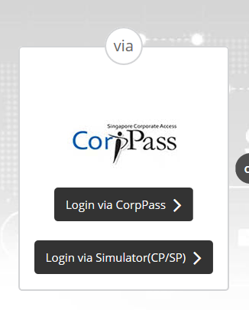
LicenceOne Application Learning Points
Learning points so far…
Follow the Licence One Guide (Step by Step with screenshots) on https://acd.mlaw.gov.sg
Main issue: Log on to LicenceOne using correct identity
Error: Log on to LicenceOne using SingPass.
Impact:
X Certificate of Registration granted to the SingPass holder (individual) instead of the business entity.
X Future amendments / updates to ACRA records NOT auto populated (e.g. new directors, shareholders, company secretary).
√ Log into LicenceOne using CorpPass
√ Certificate of Registration granted to correct entity.
√ Future amendments / updates to ACRA records auto populated.
Log in using CorpPass!
Notes:
Talking points.
We would like to share with you the learning points from applications received. These tips can help you reduce possible clarifications and the processing time for your applications.
Firstly, you need to use CorpPass to log on to LicenceOne where you are registering a business entity as a regulated dealer registration.

Slide 32
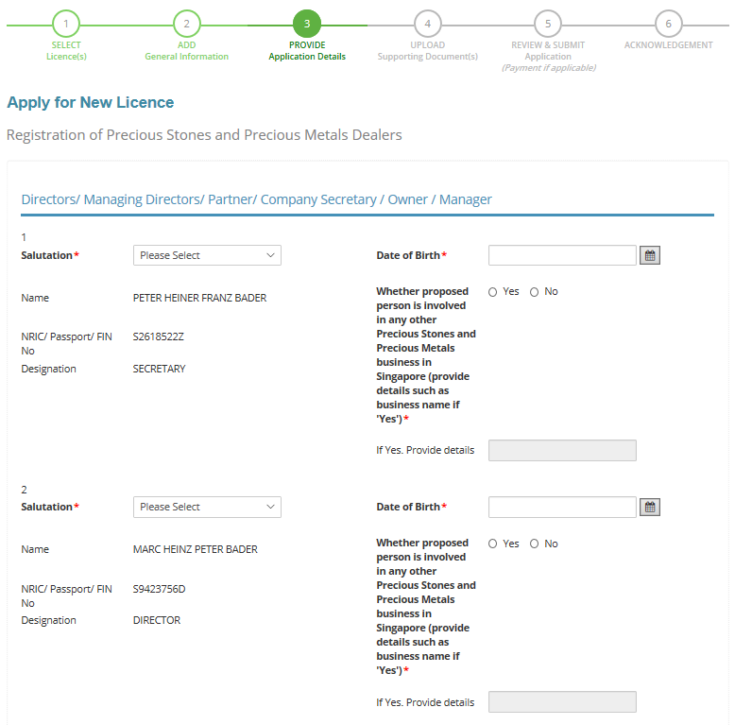
LicenceOne Application Learning Points
Learning points so far…
Are you using a third party company service provider and unable to ascertain whether company secretary is involved in other precious stones and precious metals business in Singapore?
√ If you are, select “Yes”.
√ In the <If yes, provide details> field, state “Third Party Company Service Provider”. No need to list out the other businesses.
State “Yes”
State “Third party company service provider”
Notes:
For regulated dealers who use professional company services providers as their company secretaries, you may be unable to ascertain whether company secretary is involved in other precious stones and precious metals business in Singapore.
For the question on whether the company secretary is involved in other regulated dealers (precious stones and precious metal dealers), indicate “Yes”. For details indicate “Person is a professional company services provider”.

Slide 33
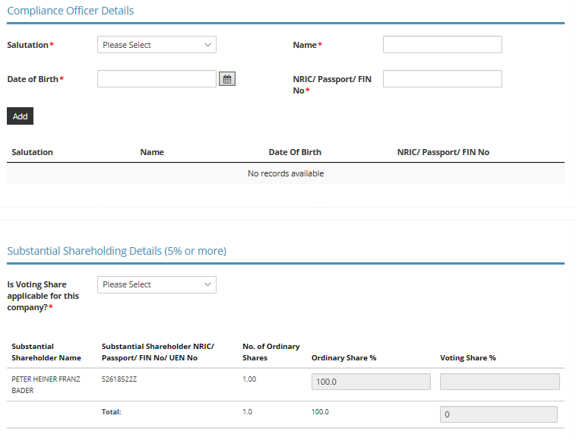
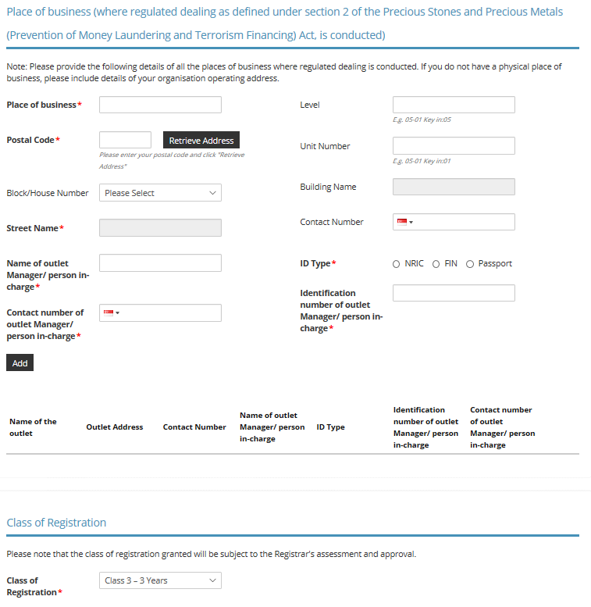
LicenceOne Application Learning Points
Learning points so far…
Who can be a Compliance Manager?
√ A management level staff from your business.
xxx
xxx
xxx
xxx
Who can be an Outlet Manager?
X Do NOT enter multiple outlets if 1 outlet has more than 1 outlet manager. You will be charged registration fees for each outlet added.
√ Enter only 1 outlet manager for each outlet.
To indicate only 1 outlet manager!
Notes:
One Frequently Asked Question is who can be a Compliance Manager.
On our FAQ website, we have indicated that
You shall appoint at least 1 Compliance Officer. The Regulated Dealer can appoint other staff/employees to assist the appointed Compliance Officer as deemed fit.
Under section 14(1)(c) of the Precious Stones and Precious Metals (Prevention of Money Laundering and Terrorism Financing) Regulations (PMLTF Regulations), a management level staff from your business can be appointed as a compliance officer.
The compliance officer is responsible for handling all AML/CFT compliance matters for your company. You may employ third parties to conduct the compliance operations. However, the appointed compliance manager needs to oversee the measures.
Hence, it is good practice to appoint the appropriate person who can be delegated the responsibility of ensuring that your business has proper Internal Policies, Procedures and Control (IPPC).
Another Frequently Asked Question is who can be an Outlet Manager.
You are required to entire only 1 outlet manager for each outlet.
If the outlet has 2 outlet managers, do NOT enter the same outlet twice. You will be charged registration fees for each outlet added to the application form.

Slide 34
LicenceOne Application Learning Points
Learning points so far…
Error: Submitted multiple applications.
e.g. 10 outlets belonging to 1 business entity (1 unique UEN).
Impact:
X Multiple Certificate of Registration granted to the same business entity.
X Duplicate application fees paid.
xxx
xxx
xxx
xxx
xxx
xxx
xxx
xxx
xxx
Add more Place of Business instead!
√ Only need 1 application for each unique business entity (based on UEN).
Notes:
Do not submit multiple applications using the same UEN, one for each outlet.
There is a risk that multiple Certificate of Registration could be issued to the same business entity. The business entity will be charged multiple application fees. Registration fees are not refundable.
<LAST SLIDE, next is Dialogue Session.>

Slide 35
dialogue session
If you have more questions, you may submit an online enquiry form at:
www.mlaw.gov.sg/eservices/enquiry
Notes:
Presentation duration: 20 minutes
11.30am to 11.50am
To have rep for (1) JK to answer policy/compliance matters, (2) JL to answer registration/renewal matters.

Slide 36
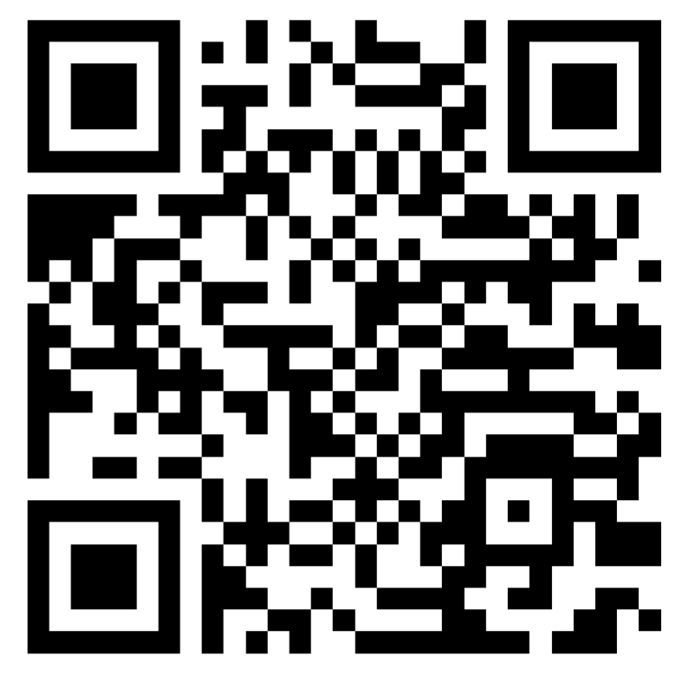
feedback form
Please provide your feedback on the Onboarding Conference at:
https://form.gov.sg/5ccc0ca38dcebc001039204d
or scan the QR code:
[Credit: Icons from www.flaticon.com]

